Slide 1
CA1 AIML CLASSFICATION
Haaris Sulaiman P2112815

Slide 2
PREDICTION TASK

Slide 3
What is the task?
The task is to predict whether a machine will possibly fail before it actually fail so that the technician can replace it without interruption the production. The output variable is the 'Machine Status' with binary values. 1 indicates failure and 0 indicates that is it still in working condition. I will be building classification models to predict which machines will have a binary value of 1 and which will have a value of 0.

Slide 4
DATA EXPLORATION

Slide 5
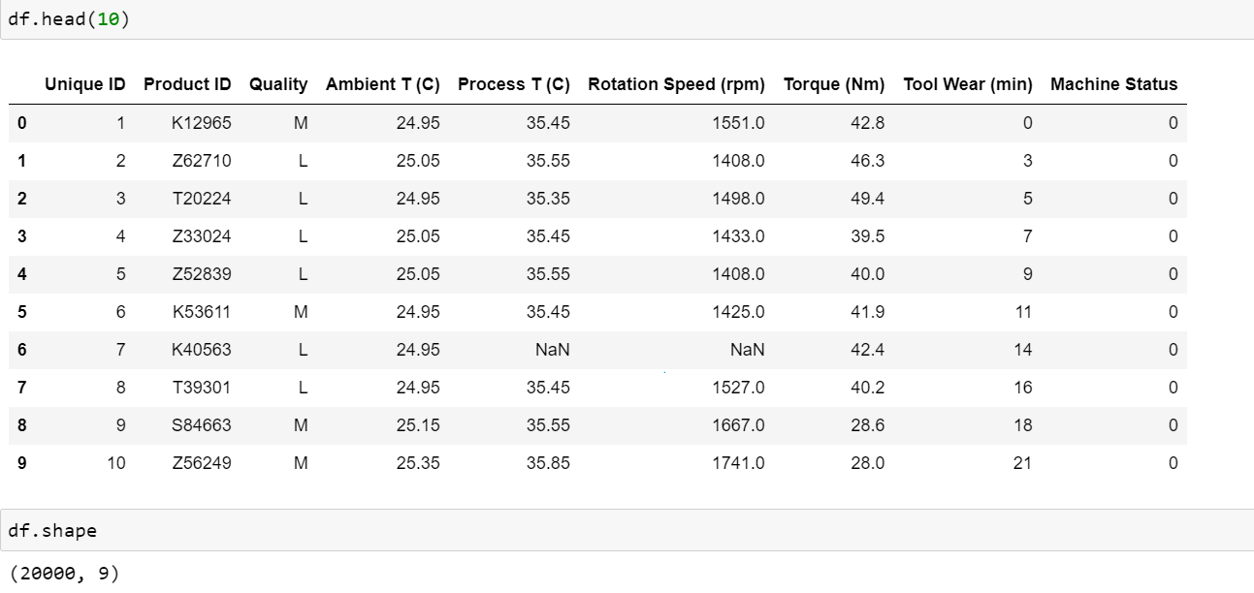
The factory dataset has 20000 rows and 9 columns of data regarding information about the machines.

Slide 6
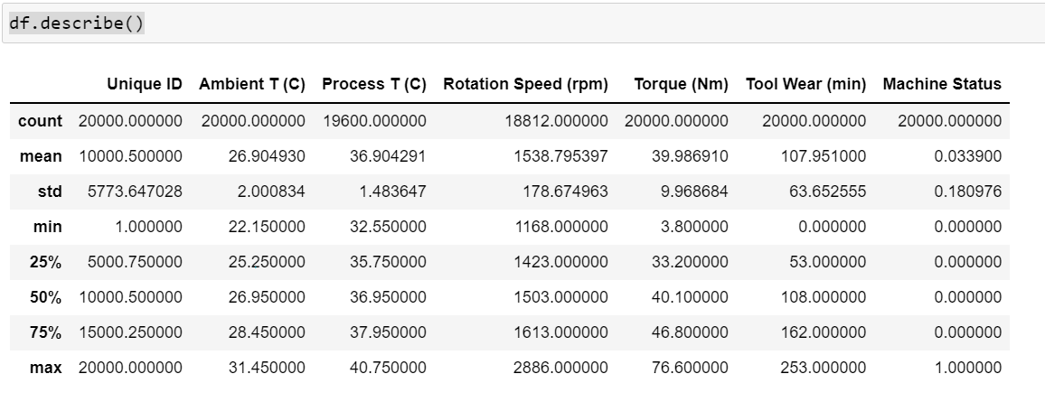
The range (max-min) for columns like Tool Wear(min) is huge and will require standardization which will be carried out in the later section

Slide 7
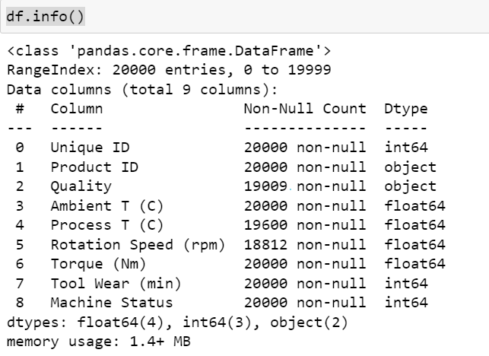
Since there are 20000 rows , we can already see that there are multiple columns will lots of null values such as quality which has 190009 non-null values instead of 20000.

Slide 8
DATA CLEANING

Slide 9
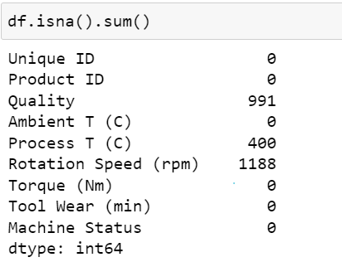
There are null values in 3 columns. I can either drop the null rows or fill it with null values. I choose to fill the null rows with values so that the data can be used instead of being discarded. I will fill in the values with consideration to the range.

Slide 10
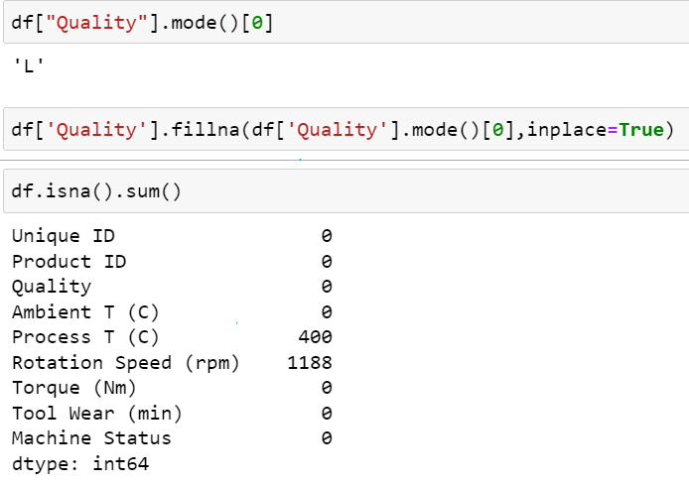
I filled all the null values of Quality with the mode. Since there are only 3 categories, and the values are strings instead of numbers, I feel that it will be more suitable to use mode.

Slide 11
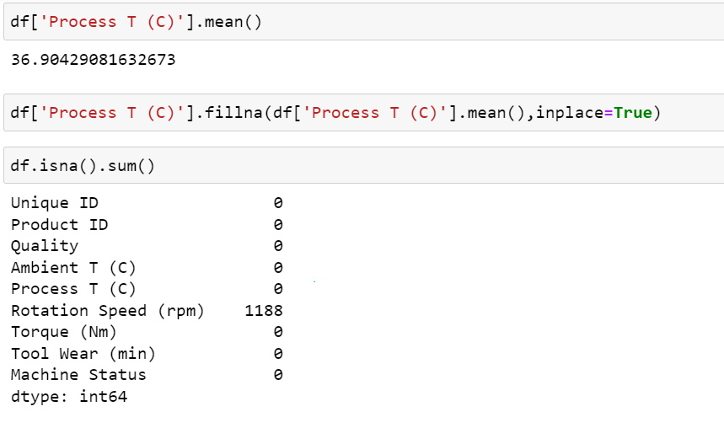
I used the mean values to replace the null rows for Process Temperature.

Slide 12
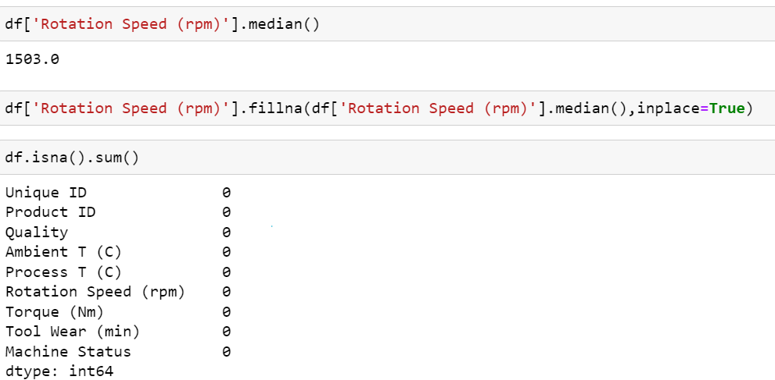
I filled Rotation Speed with the median and now there are no more null rows

Slide 13
FEATURE ENGINEERING

Slide 14
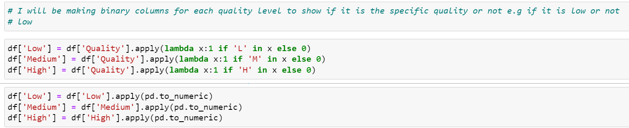

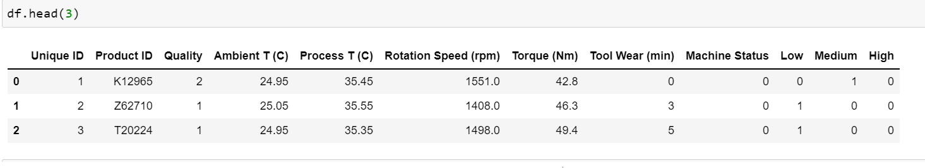
I did binary encoding and made 3 additional features which will determine whether the machine has that specific quality. This is also important as the model will not work on strings. That is why I also used p.to_numeric to change the data type. I will drop quality since its no longer needed.

Slide 15
EXPLORY DATA ANALYSIS

Slide 16
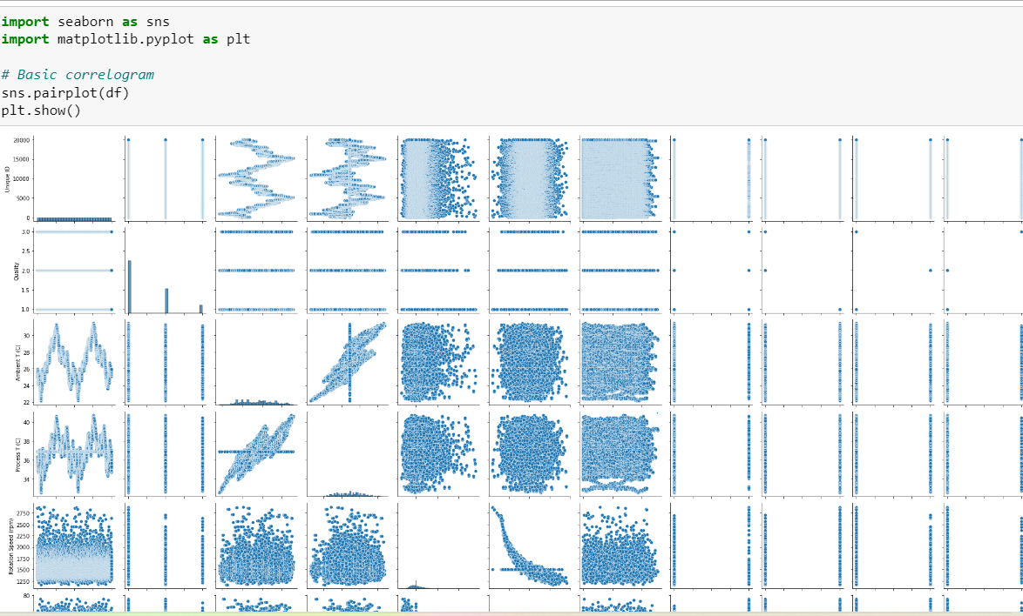

Slide 17
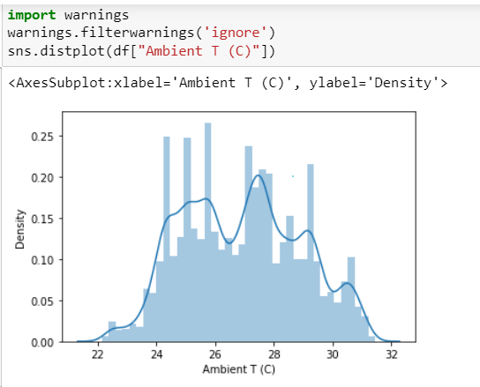
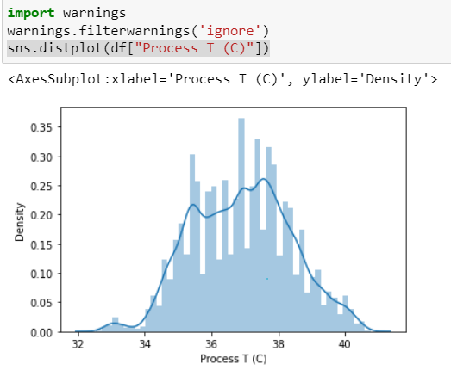
I plotted distribution plots for both Process and Ambient Temperature and we can observe there is a symmetrical distribution

Slide 18
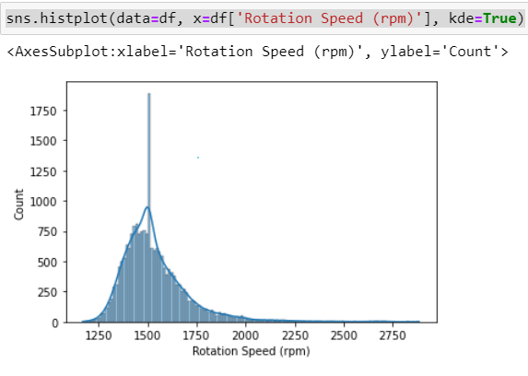
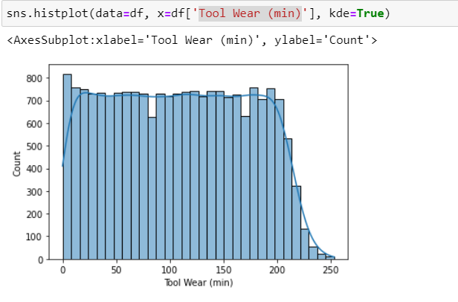
I plotted histograms for tool wear and rotation speed

Slide 19
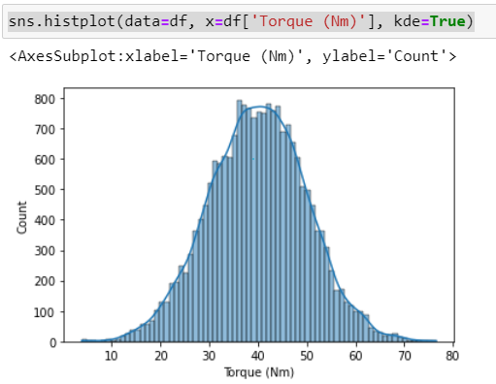
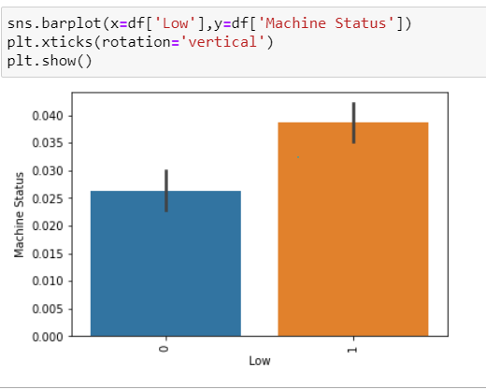
I plotted a histogram for Torque and a bar chart for ‘Low’ quality

Slide 20
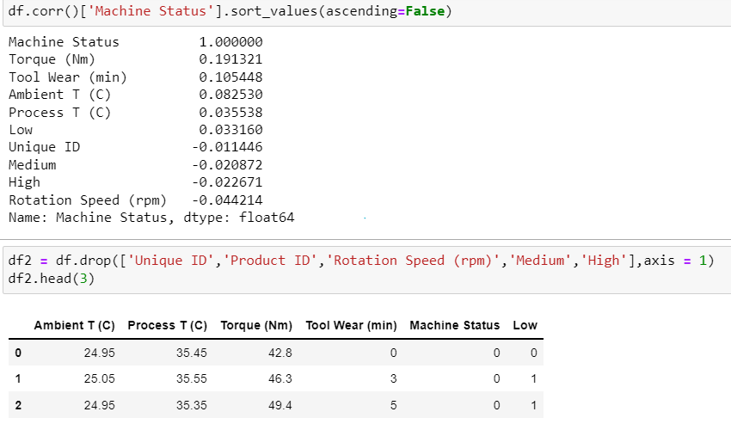


Slide 21
FITTING THE MODEL

Slide 22
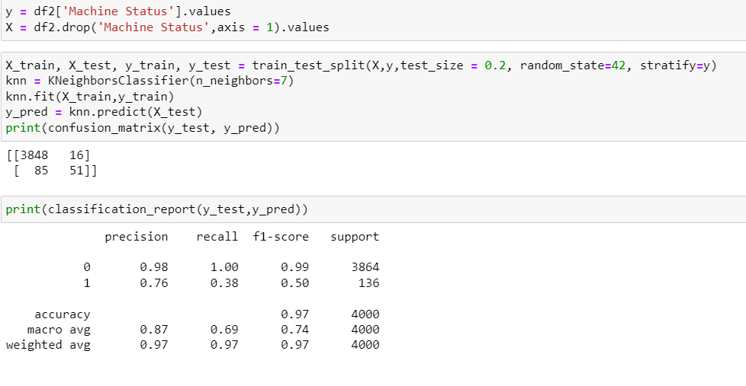
KNN Classifier

Slide 23
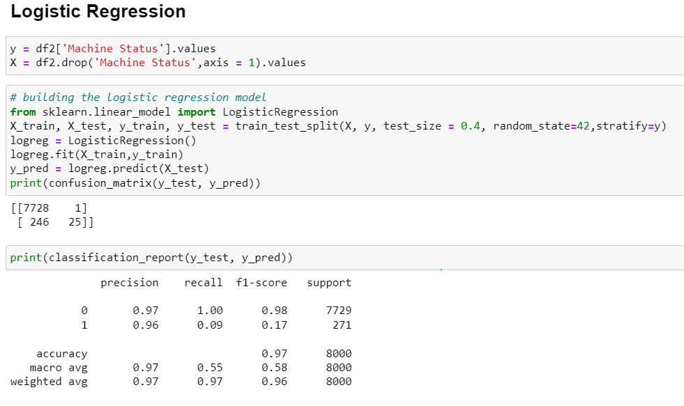
Logistic Regression

Slide 24
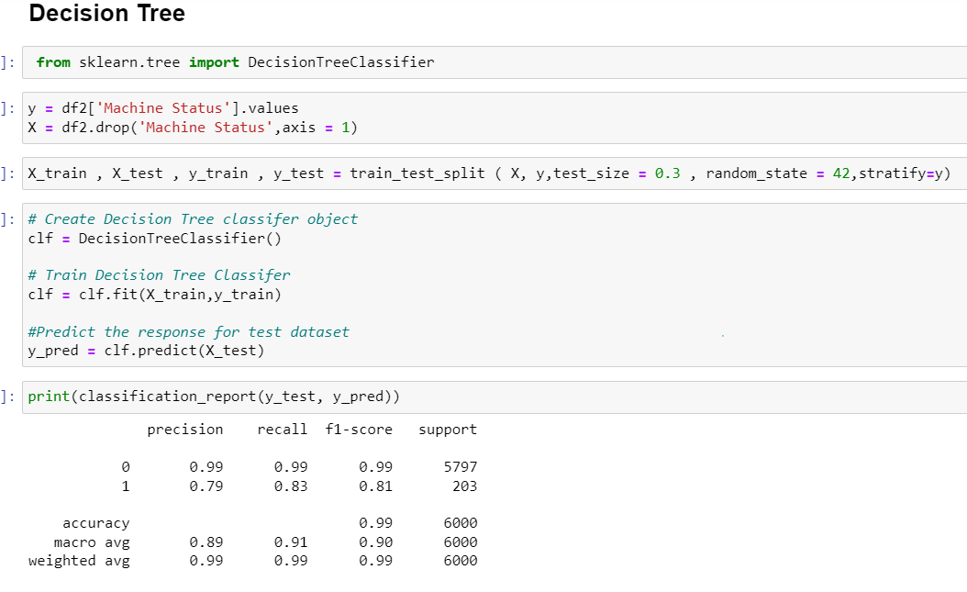
Decision Tree Classifier

Slide 25
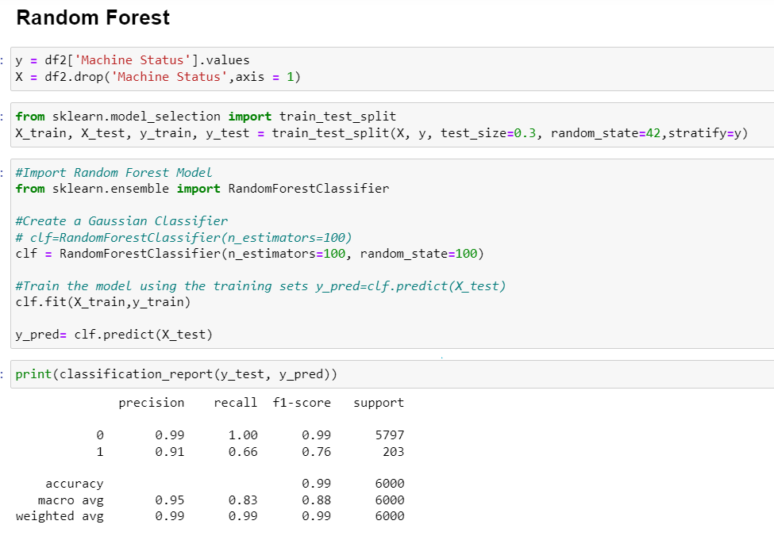
Random Forest

Slide 26
MODEL SELECTION

Slide 27
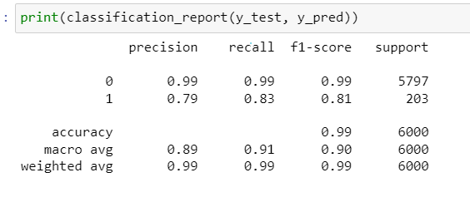
Choosing the best model
Selected Model: DecisionTreeClassifier()

Slide 28
CROSS VALIDATION & HYPERPARAMETER TUNING

Slide 29
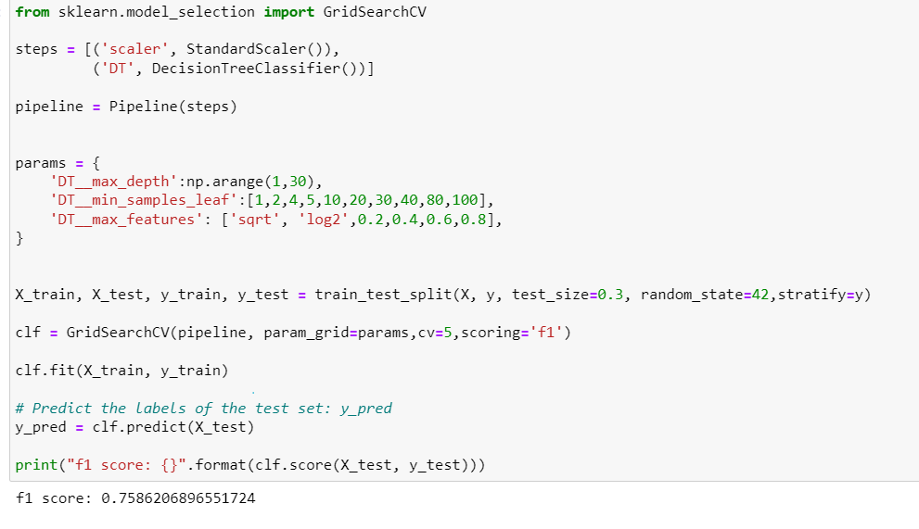

Slide 30
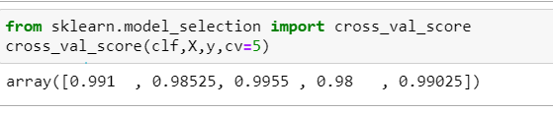
Cross validation score
The cross validation scores are high indicating that the Decision Tree Classifier model performs well on unseen data and is not overfitted.

Slide 31
MODEL IMPROVEMENT

Slide 32
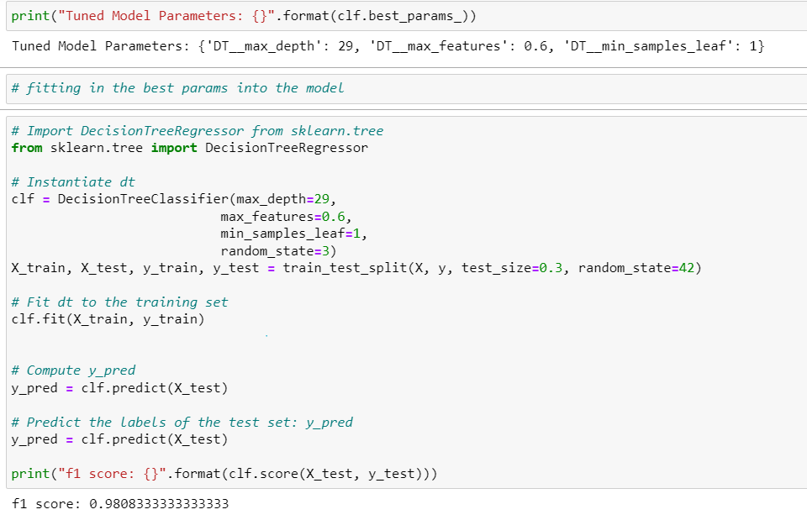

Slide 33
MODEL EVALUATION & CONCLUSION

Slide 34
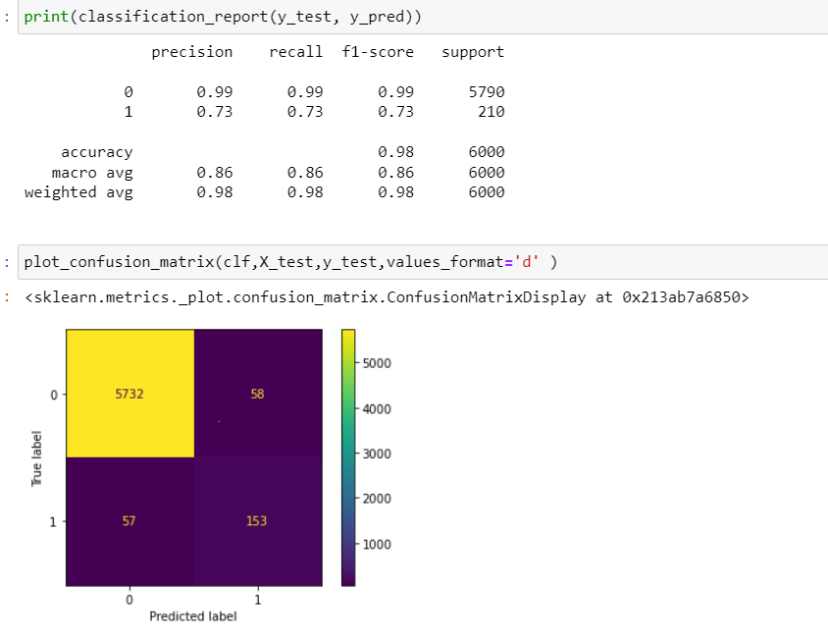
Since there are still false positive and false negative values in the confusion matrix. This shows that the model is not perfect and is still making errors when predicting

Slide 35
Performance of model
Before tuning: After tuning:
F1 score: 0.99 F1 score: 0.98
There is only a subtle difference. The Decision Tree Classifier has the highest f1 score and it is not overfitted, performing very well on new data. Hence, Decision Tree Classifier is the best model for this prediction task

